Slide 1
Estimating galaxy shape and flux with CNNs
Final project CS109b Spring 2020
Ziwei Qui, Hayden Joy, Zach Murray, and Dan Cox
Problem Statement:
We have been given a file of 18779 simulated galaxy images and asked to use them to:
Train a CNN to estimate five parameters commonly associated with galaxy images.
Assess the CNN’s performance on a sample of mock images.
Motivation:
Such a tool could be used to describe and then classify new galaxy’s as they are identified.

Slide 2
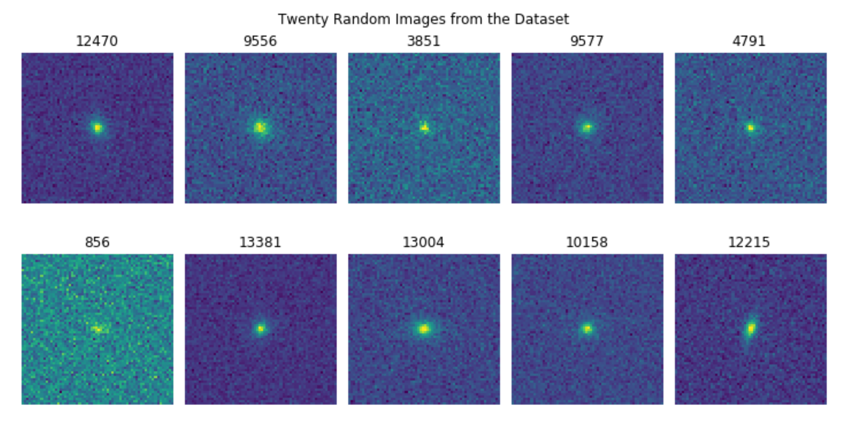
A sample of the Galaxy Data
Ten random images from the dataset

Slide 3
The five parameters to be estimated
Flux — brightness divided by area
Sérsic index — the degree of curvature of the galaxy profile.
Sérsic radius — half-light radius
g1 — orientation
g2 — ellipticity

Slide 4
What we have done:
We have generated:
5 CNNs each estimating a single parameter.
1 CNN that estimates all parameters at once.
We have examined the performance of the models’ with respect to:
Variations in background noise vis-à-vis the Cramer-Rao bound.
Differences between the point spread function used in the training vs the testing data.
The galaxies not being centered in the image
We have also done some baseline modeling not involving neural networks,
but rather more conventional approaches

Slide 5
1 CNN (5 outputs):

Slide 6
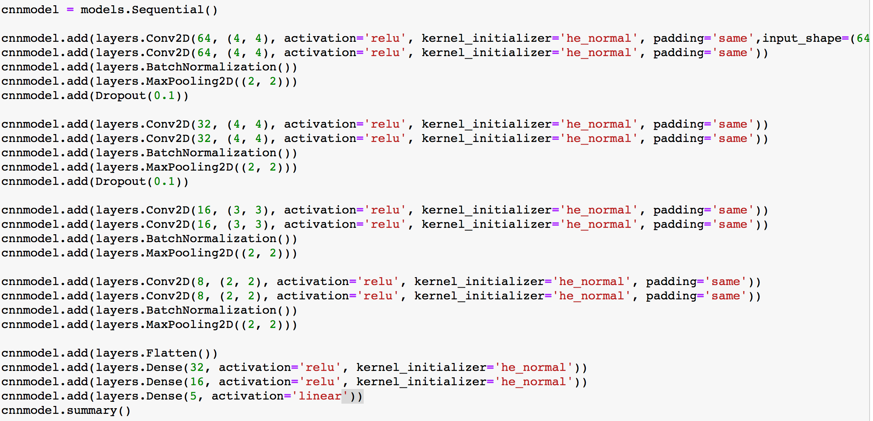
Architecture of the CNN (5 outputs):

Slide 7
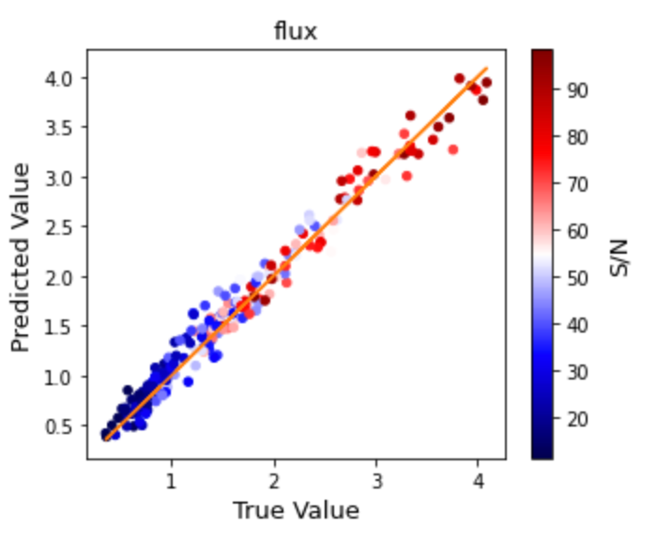
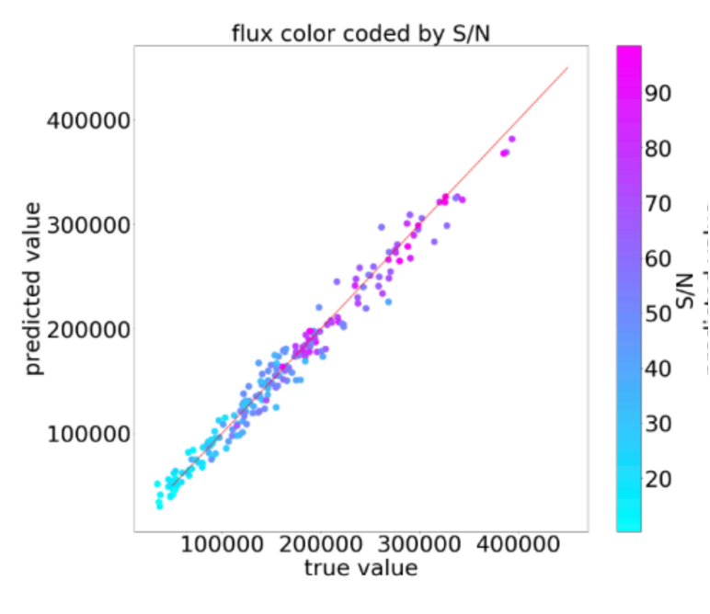
Results of the CNN (5 outputs):
Ours
Benchmark
flux —brightness divided by area

Slide 8
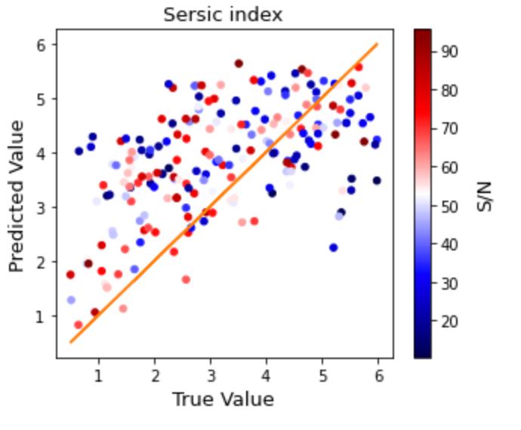
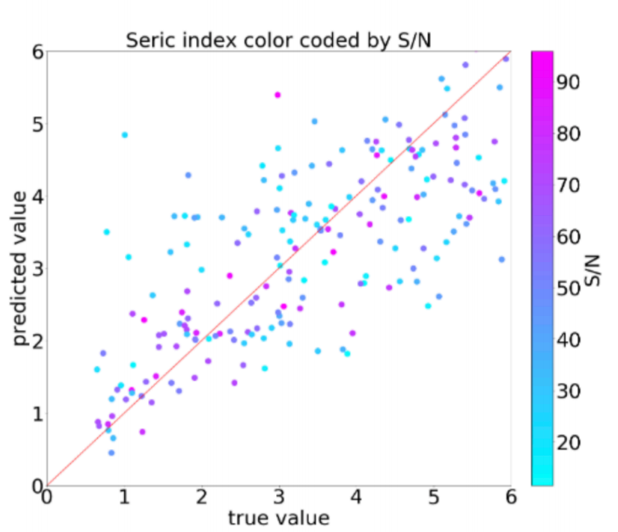
Results of the CNN (5 outputs):
Sersic index — curvature
Ours
Benchmark

Slide 9
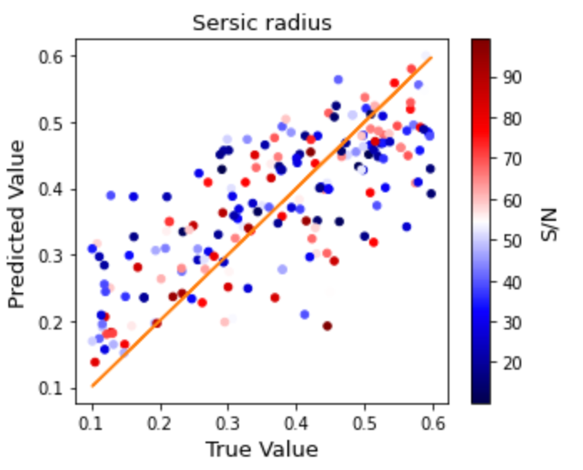
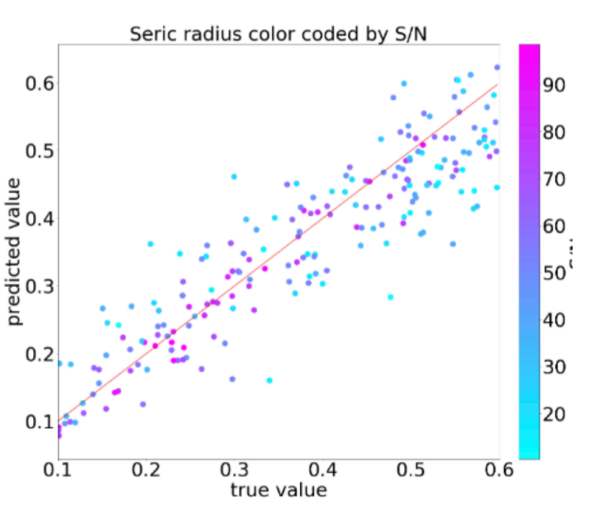
Results of the CNN (5 outputs):
Sersic radius — half-light radius
Ours
Benchmark

Slide 10
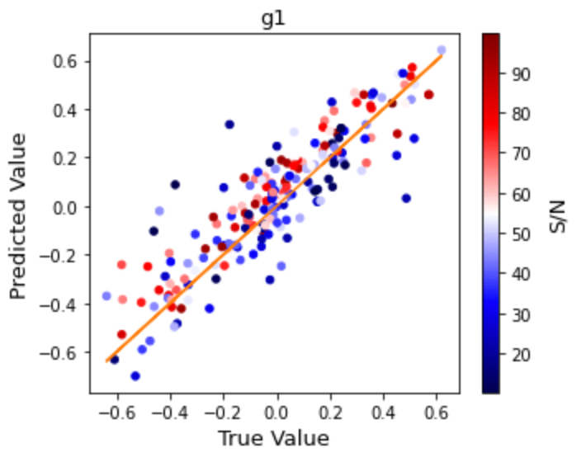
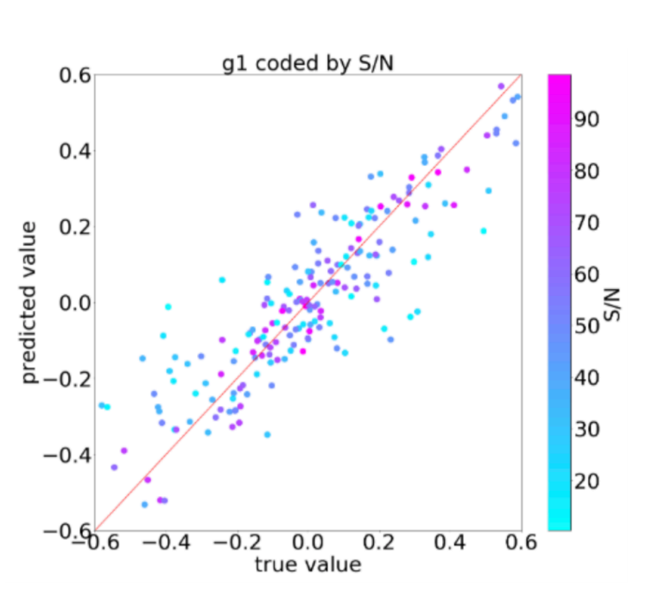
Results of the CNN (5 outputs):
g1 — orientation
Ours
Benchmark

Slide 11
Results of the CNN (5 outputs):
flux —brightness divided by area

Slide 12
Results of the CNN (5 outputs):
Sersic index — curvature
Sersic radius — half-light radius

Slide 13
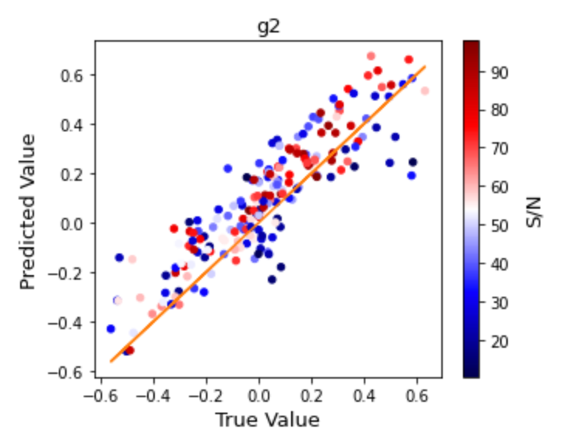
Results of the CNN (5 outputs):
g1 — orientation
g2 —ellipticity

Slide 14
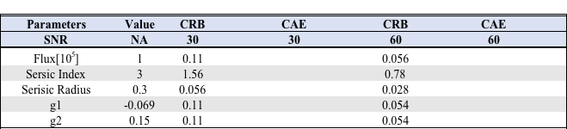
Results of the CNN (5 outputs):
CRAMER-RAO Bound Comparison

